Slide 1
Web Technologies
Lab-III
Cascading Style Sheets

Slide 2
The Problems with HTML – Poor Coding
No consistency in the way a document is developed.
The same markup can often be written a number of ways.
One can omit attributes, or include irrelevant or illegal attributes, with the browser usually ignoring the problems. It seemingly encourages poorly written code.
<table border>
<table border=“1”>
<table>
<table bdr> (wrong syntax)
<table border=“0”>
2

Slide 3
XHTML vrs HTML
XHTML | HTML
All elements explicitly closed eg: <br /> | Not necessary eg: <br>
All elements/attributes must be lower case | Case insensitive
Must have quotes for attributes eg: <body lang=“en”> | Quotes not necessary eg: <body lang=en>
Necessary to have: <html>, <head>, or <body> | Not necessary
Recommendation: Use XHTML.
3

Slide 4
The Problems with HTML – Coding Design
As appearance and design became a central issue (with disregard to rules) new design tags were created.
<font> is the classic example. It defines typographic presentation of the page. However this tag is not easy to use. Every time you change an attribute of the font, you must close and re-open the tag.
You must open and close them every time you apply this tag to sections of your document. For example, to define the font to be used table cells, the definition must be repeated in each cell, it cannot be done as a global setting.
4

Slide 5
The Problems with HTML - Compatibility
The initial goal of HTML was across platforms. Unfortunately this goal has been degraded.
Distinct differences between the main browsers, and how they interpret HTML.
Proprietary tags introduced due to browser war. For example:
<blink> only works for Netscape
<marquee> only works for Internet Explorer.
5

Slide 6
Solution: Separate Structure from Appearance
There is a return to the old school of thought, one which requires a language that clearly separates the definition of a document’s structure, from the definition of a document’s appearance.
This separation reduces to the design or appearance being a transformation using a style language operated over the structure.
The standard language for doing this is “Cascading Style Sheets” (CSS), like HTML 4.0, CSS is an official W3C recommendation: http://www.w3.org/TR/REC-CSS2
6

Slide 7
Cascading Style Sheets (CSS)
<font face=“Courier” size=“6” color=“black”>some text</font>
<head>
<style type=“text/css”>
<!--
.defined {font-family: Courier; background-color:red; color:black; font-size: medium}
-->
</style>
</head>
<body>
<p><span class=“defined”>some text</span></p>
</body>
7

Slide 8
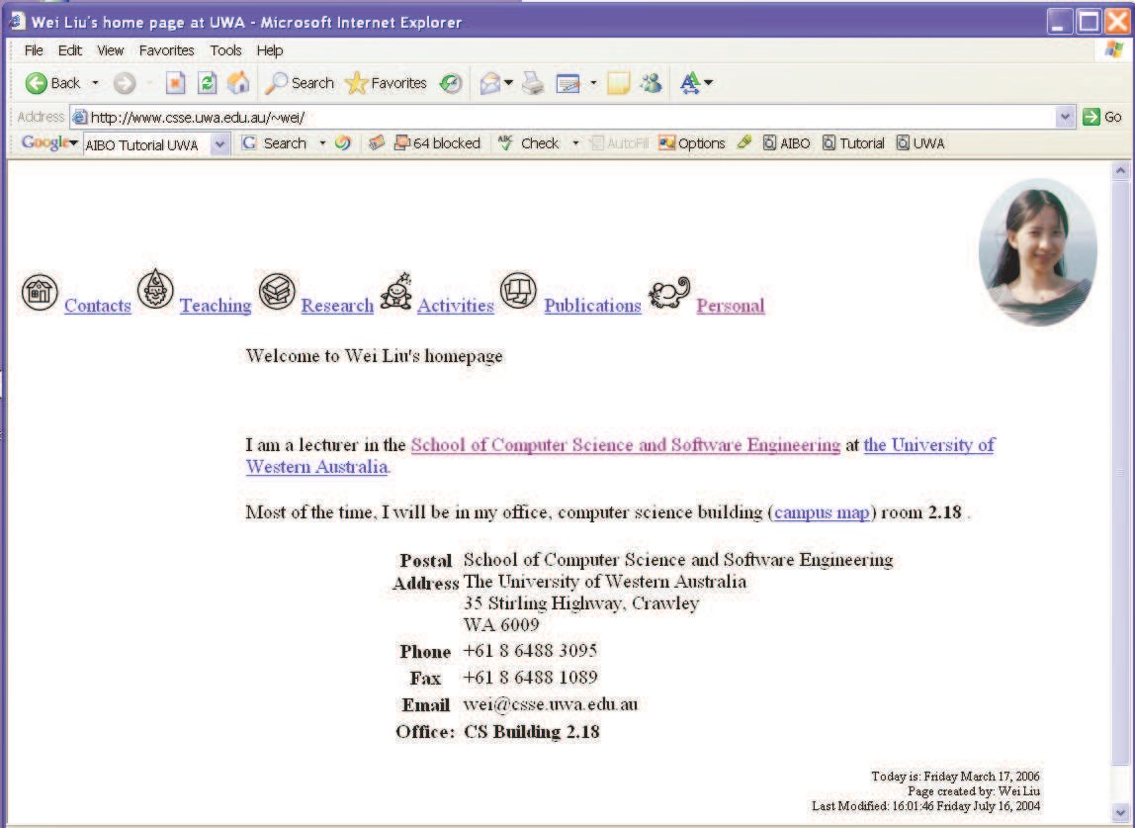
Rendering without CSS

Slide 9
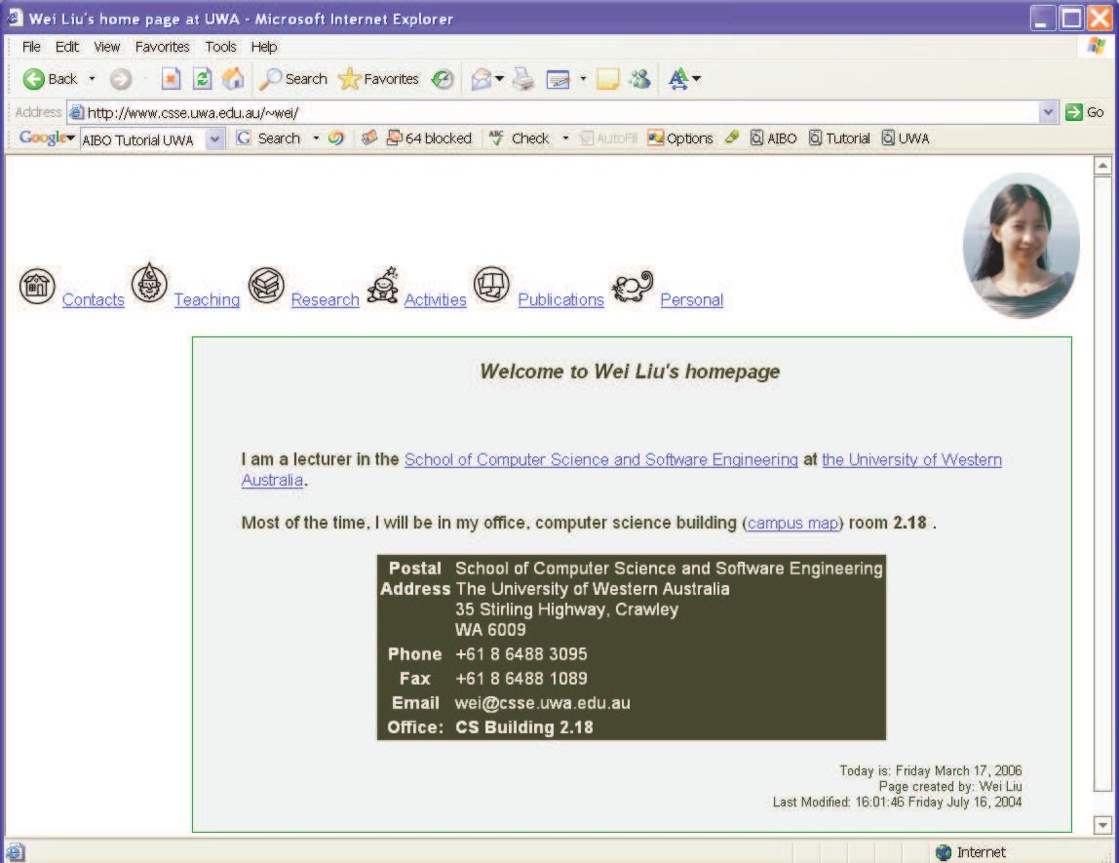
What a difference CSS can make!

Slide 10
Types of CSS
There are three ways of specifying styles:
External style sheet (multiple pages can link to this).
Internal style sheet (applies only to specify web page).
Inline style (applies only to the specific element).

Slide 11
Style Rule Syntax
Each style rule is of the form:
selector { property:value; property:value; ...; property:value; }
Selectors determine which markup elements the style properties and values apply to. Example:
h1 { color: white; background-color: orange }

Slide 12
Inline Styles
Each browser has default display style.
Inline styles can be used to customise how elements are displayed. Examples:
<body style="background-color:yellow">
<h1 style="text-align:center">
<p style="font-family:courier new; color:red; font-size:20px">

Slide 13
Disadvantages of Inline Styles
If all h2 headings need to use a certain font and alignment, then every time we specify a h2, we need to duplicate presentation attributes:
<h2 style="text-align:center; font-size:10px"> blah blah </h2>
Each time we want to change the style for h2, need to search and replace everywhere.
For large web pages/sites this leads to complexity and maintenance issues. Could be tens or hundreds of occurrences across tens of web pages.
How to cope with on-screen display versus printed
How to display same page on mobile phone or text browser?
Not easy to copy the presentation style from one web page to another.

Slide 14
Embedded Style
They specify uniform styles for each element in given page.
Are specified in the head of your HTML document:
<head>
<style type="text/css">
<!—
h2 style="text-align:center; font-size:10px">
-->
</style>
</head>
Older browsers do not support embedded style hence use of comments.

Slide 15
Embedded Style
Advantages:
Uniform display of each element type within a given web page.
Easy to change – one location at head section.
Disadvantages:
To make several web pages look same, need to duplicate the embedded style in each one.

Slide 16
External Style Sheet
Style rules stored in a separate file (eg mystyle.css).
Each page wishing to use this style links to this external file:
<head>
<link rel="stylesheet" type="text/css" href="mystyle.css" />
</head>
External style sheet contains list of style rules.
Advantages:
Many pages can share same style easily.
Easy maintenance – just change external style sheet.

Slide 17
What does it all mean?
Each line in the style sheet looks something like:
– p {color: blue}
p is the selector. This is the element to apply the style to.
color is the property.
blue is the value that we wish to set the property to.

Slide 18
Style precedence for one document
Three ways to apply a style to an HTML or XHTML document:
Inline Styles
Embedded Styles
External Styles
Style precedence
Inline > embedded > external

Slide 19
HTML <div> Tag
The <div> element, to mark logical blocks within a document.
Used to group block-elements to format them with styles.
<div style="color:red">
<h3>This is a header</h3>
<p>This is a paragraph.</p>
</div>

Slide 20
HTML <span> Tag
Used to mark sub-sequences of text.
Styles can be applied to text marked with <span>:
<p>
I have <span style=color:brown;">brown</span> eyes and my wife has <span style="color:blue;">blue</span> eyes.
</p>

Slide 21
HTML class Attribute
Marks scattered members of a particular conceptual group.
<html> <head>
<style type="text/css">
span.blue {color:lightskyblue; font-weight:bold;} span.brown {color:brown; font-weight:bold;}
</style>
</head><body>
<p> I have <span class=“brown"> brown</span> eyes and my wife has <span class="blue">blue</span> eyes. </p>
</body></html>

Slide 22
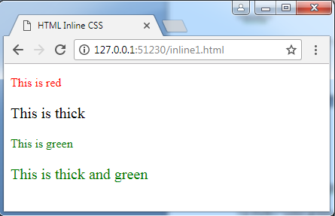
List of Exercises
1. Create a HTML document using inline style sheet.

Slide 23
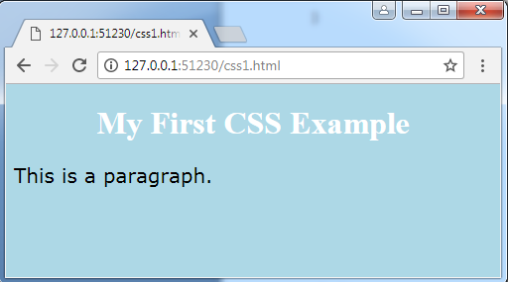
2. Create a HTML document using internal style sheet.

Slide 24
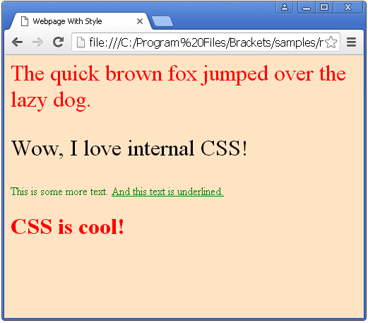
3. Create a HTML document using External style sheet.

Slide 25
Pre-lab Viva Questions
1.How can you add style in HTML document?
2. List the different HTML block elements. 3. List the different HTML inline elements. 4. How many grouping tags are present in html.
5. What is the use of HTML Layouts?
6. How can you create email links in HTML?
7. What happens if you open the external CSS file in a browser?
8.Differentiate between id selector and class selector.
9.write the purpose of float, overflow properties in CSS.
10.What is the importance of <DIV> tag and<SPAN> tag.

Slide 26
Text books and References
Textbook: HTML, XHTML and XML (3rd edition - comprehensive), by Patrick Carey, Course Technology.
Online reference & tutorials: https://www.w3schools.com/csSref/sel_class.asp
Anybody can knock up a web page but few can make them striking.
If you find a striking web page, view its HTML source (IE: View-
>Source). Learn new and different HTML techniques by seeing how others do it.
YouTube Video Lecturers:
https://www.youtube.com/watch?v=qKoajPPWpmo&list=PLr6-GrHUlVf8JIgLcu3sHigvQjTw_aC9C
26

